Slide 1

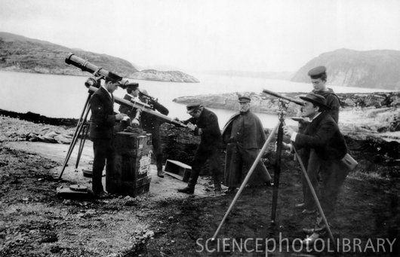


Slide 2
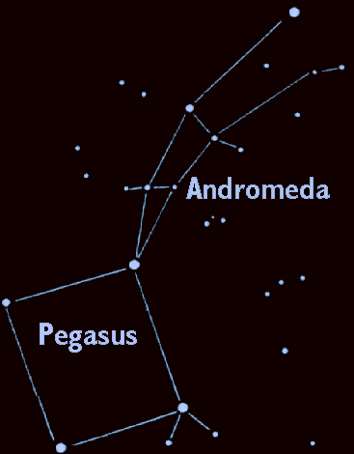
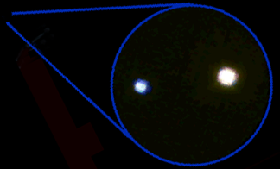
Gamma Andromedae Through the Telescope
When seen through the telescope Gamma Andromeda turns out to be two stars of different colors.
This is a contrast multiple star - two (or more) stars, of different color and brightness, orbiting each over.

Slide 3
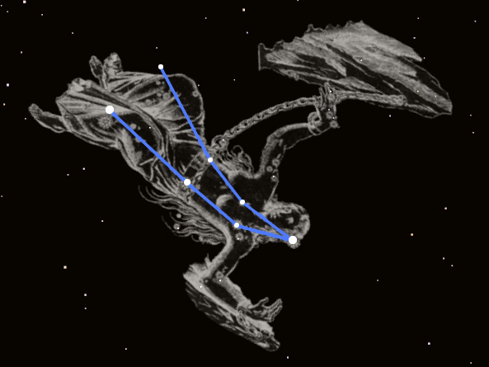
Gamma Andromedae
the 3rd brightest star in the constellation Andromeda
"The Chained Maiden"
Gamma Andromedae

Slide 4
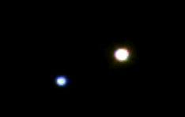

Star Pairs
Pairs of stars can come in two types:
Optical Double Stars
Binary Stars

Slide 5

Optical Double Stars
Optical Double stars are just two stars that happen to lie in the same direction in the sky.
(A side view)
If you could see these stars from a different vantage point than Earth, you would see these stars actually have nothing to do with each other.

Slide 6

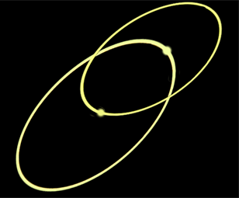
Binary Stars
In a binary star system the stars are together in space and orbit each other.
Massive star with small companion
2 stars of similar mass

Slide 7

How do You Tell Which One You Are Looking At ?
It's all in the distance.
Binary stars are together in space so they are about the same distance from Earth.
Optical Double stars are very large distances apart.

Slide 8
How can we find the distance to a star?
Earth
Nearby star
ρ
Background stars
Sun
d
ρ
Apparent positions of the nearby star for observations taken 6 months apart.
Photographing a nearby star from different sides of our orbit makes the star seem to shift in the sky. This shift, called parallax, can be used to find the distance to nearby stars.

Slide 9
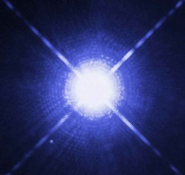
What Makes Stars Shine?
In the 1920's, astronomers were still not yet sure what made stars shine. Some of their ideas were:
Coal.
The constant in-fall of comets and meteors.
The decay of radioactive elements.
Nuclear reactions.
?

Slide 10
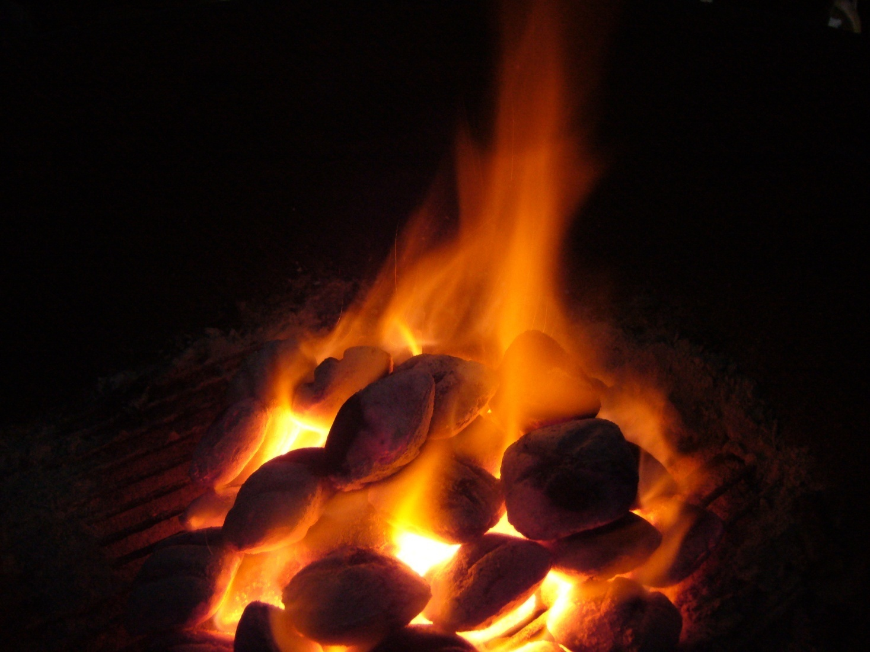
What Makes Stars Shine –
coal?
Coal was immediately dismissed. An object the size of the sun made entirely of coal would only burn for about 10 thousand years and it was known that the Earth was billions of years old.
Wrong!

Slide 11
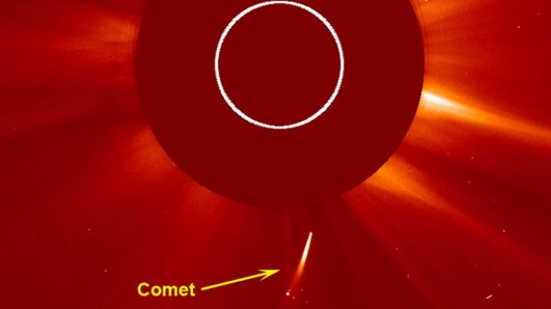
What Makes Stars Shine –
constant in-fall of comets & meteors?
The idea was that as comets and meteors fell into a star they would disintegrate and their matter would be turned into energy.
Wrong!

Slide 12
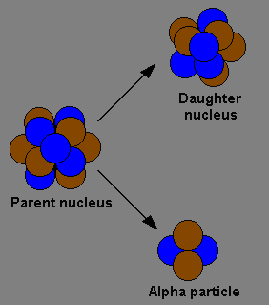
What Makes Stars Shine –
the decay of radioactive elements?
Each star had an assortment of elements which decayed at different rates. It was thought that as one source ran out another would take over.
Wrong!

Slide 13
What Makes Stars Shine?
By the end of the 1920’s astronomers were convinced that the energy to power stars came from the annihilation of atoms …
Nuclear Fission
Large Atom
+ ENERGY
Close but no cigar!
Smaller Atoms
which led to the following (incorrect) conclusion:

Slide 14
What Makes Stars Shine?
  Astronomers thought stars started out large, massive, hot and blue. As they age they gradually shrink to smaller, less massive, cooler white stars, then yellow and finally red dwarf stars.
Size, Mass & Temp.
Wrong!
Age

Slide 15
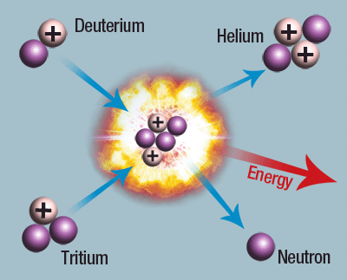
What Makes Stars Shine –
Nuclear Fusion!
Astronomers thought nuclear fusion would only work well for small stars. This idea had trouble gaining acceptance because large stars fueled this way would only last 300 million years or so - much shorter than the Earth’s lifetime.
Correct!

Slide 16
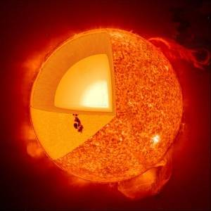
What Makes Stars Shine?
Today it is known that the energy generated by stars comes from nuclear fusion reactions which turn hydrogen into helium with the release of energy.

Slide 17
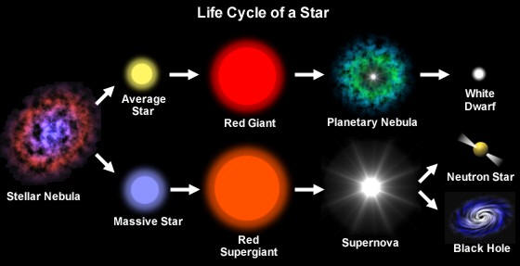
What Makes Stars Shine?
We also know that stars do not start out as blue-white stars and evolve into yellow stars, eventually ending up as red dwarfs.

Slide 18
Contrast Multiple Stars
Blue stars are more massive and hotter than yellow or red stars. Stars of different masses evolve differently.

Slide 19
Why Are Stars Different Colors?
Stars form with different amounts of hydrogen. High-mass stars have lots of hydrogen so they burn hotter and faster than stars with less fuel.
Thus high-mass stars have different temperatures, colors and life-spans than low-mass stars.

Slide 20
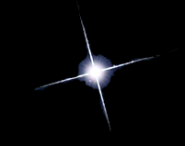

Types of Middle-Aged Stars
Blue stars are
high-mass hot stars.
Yellow stars are similar to our Sun. They are average in mass and temperature.
Red stars are
low mass and cool.

Slide 21
Contrast Multiple Stars
Can you identify:
Which star is brightest?
Which star is hottest?
Which star is largest?

Slide 22
Contrast Multiple Stars
In this case, the blue star is the hotter of the two, yet the yellow star is the brightest.

Slide 23
Contrast Multiple Stars
How can a star be brighter if it is cooler?

Slide 24
How Can a Star be Brighter if it is Cooler?
Two possibilities:
If it is a Multiple star, the cooler star may be larger.
If it is an Optical Double, the cooler star may be nearer to Earth.

Slide 25
Contrast Multiple Stars
The stars shown here are multiple stars, so they are the same distance away.
In this case the yellow star is brighter, so it must be larger.
As it turns out, the yellow star is starting to die, so it is growing into a giant.

Slide 26
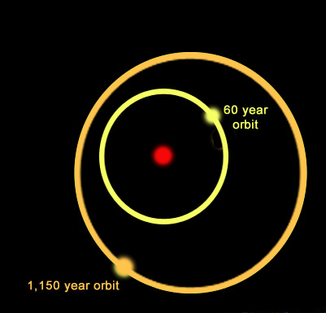
Multiple Star Systems
Star systems can come in many varieties. For example, the system shown here is a triple star system:
A yellow star orbits a primary star with a period of nearly 60 years while a more distant companion orbits the inner pair with a period of 1,150 years.
One multiple star system has 9 stars!

Slide 27
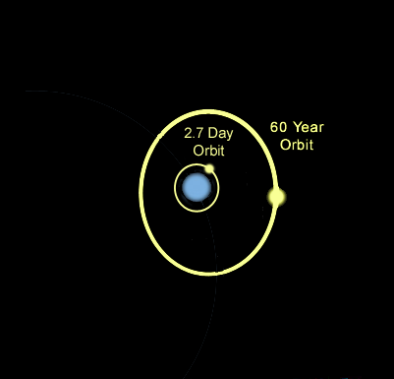
The blue star (Gamma Andromeda B) turns out to have two more stars orbiting it.
The first star is only one million miles away from Gamma Andromeda B. That's so close that it's orbit is less than 3 days!
The second is a white star about three billion miles away with a 60 year orbit.
Gamma Andromeda B is thus a triple star system!

Slide 28
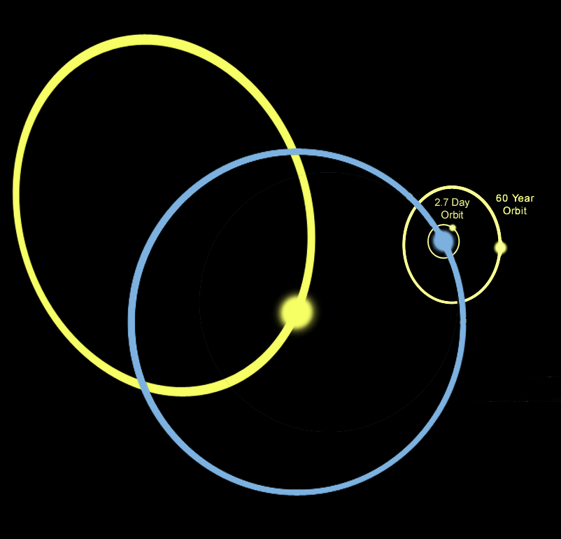
Gamma Andromedae System
This means that Gamma Andromedae has a total of 4 stars orbiting each other!

